Slide 1

Use Permit 25-004
Valletta Transient Rental Permit
June 25, 2025

Slide 2


Project Description
Location: 34 Foster Avenue, June Lake, CA
Land Use Designation: Mixed Use (MU)
Parcel Size: 0.23 acres (10,000 sq. ft.)
Proposed Project: Transient Rental permit for two of four units located at the project location. (All four units are presently vacant.)
  Applicant intends to utilize a local property manager for transient rentals

Slide 3
Project Description
Four 2BR units
768 square feet each
Originally developed in 1979/80
Permitted for transient rentals in 1992 but use has since discontinued
Subject parcel is immediately surrounded by parcels with Mixed Use land use designations which have been developed with single-family and multi-family residences
Nearly identical proposal was denied in 2022

Slide 4
Issues Noted in 2022 Denial
Inadequate snow storage area
Setback concerns relating to rear property line
Lot coverage
Ultimate reason cited for denial: Approval would result in a reduction in the number of residential units available for long-term rental

Slide 5
Issues Noted in 2022 Denial
Inadequate snow storage area
Setback concerns relating to rear property line
Lot coverage
Approval would result in a reduction in the number of residential units available for long-term rental

Slide 6
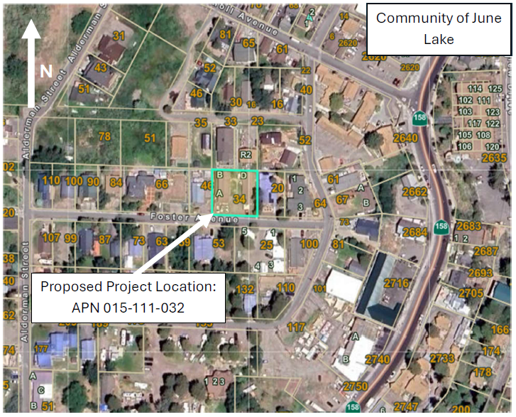
Project Location
34 Foster Avenue

Slide 7
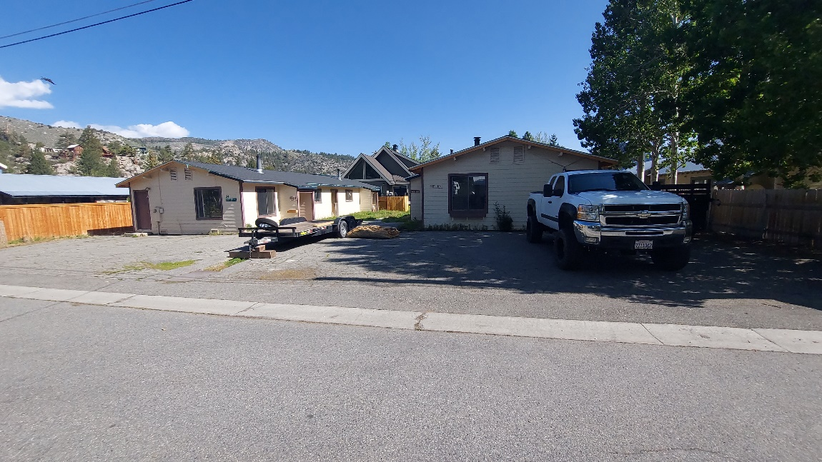

Slide 8
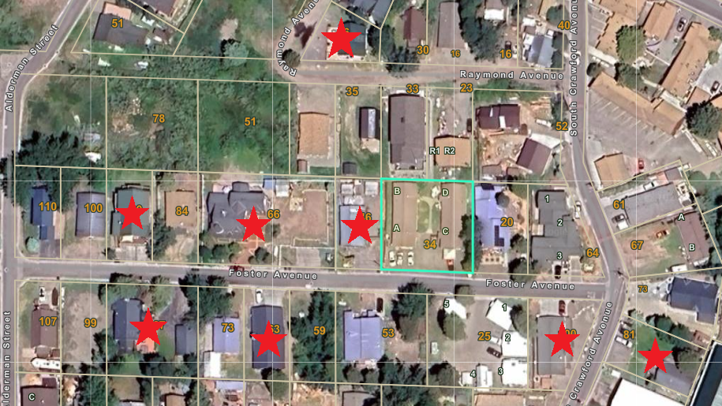
Notes:
Staff report notes eight STRs within 250 feet. It’s now nine since the Board approved UP24-002.

Slide 9
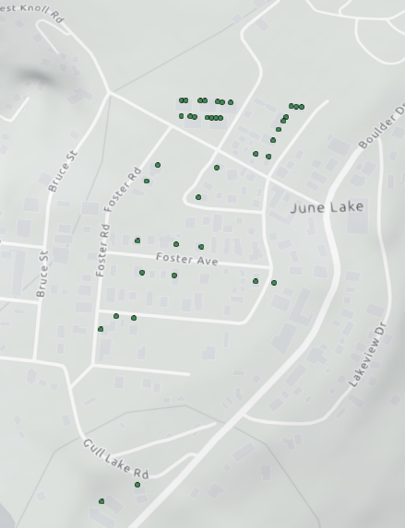
Permitted visitor rentals in the June Lake Village
Notes:
Staff report says 37 in the village; there are now 38, plus the two just outside the Village shown on the bottom left.

Slide 10
California Environmental Quality Act (CEQA)
If transient rentals are approved, the project is consistent with a Class 1 CEQA exemption.
  Class 1 (§15301) consists of the operation, repair, maintenance, permitting, leasing, licensing, or minor alteration of existing public or private structures, facilities, mechanical equipment, or topographical features, involving negligible or no expansion of use beyond that existing at the time of the lead agency's determination.
If transient rentals are not approved, the project is statutorily exempt under CEQA Guidelines §15270 (Disapproved Projects).

Slide 11
General Plan Consistency – Land Use Designation
The intent of the Mixed Use land use designation is to provide for compatible resident- and visitor-oriented residential and commercial uses, including business, professional, and retail uses; to provide for efficient use of land and increased opportunities for affordable housing; and to provide a transition between intensive commercial uses and residential uses.
Transient rentals are permitted in the Mixed Use land use designation.
  Typically, transient rentals in the Mixed Use land use designation are permitted subject to Director Review.
  Due to recent direction from the Board of Supervisors, all transient rental applications are presently being elevated to require Use Permits.
Notes:
The MU LUD allows for transient rentals, historically subject to Director Review; however, on April 16, 2024, the Mono County Board of Supervisors adopted Resolution R24-038 which states, in part, that “[s]hort-term rental projects are controversial, and therefore any such proposed project application that may be subject to a Director Review Permit shall be elevated to a Use Permit pursuant to General Plan Land Use Element (GP LUE) §31.010.” As such, this transient rental application has been elevated to a Use Permit.

Slide 12
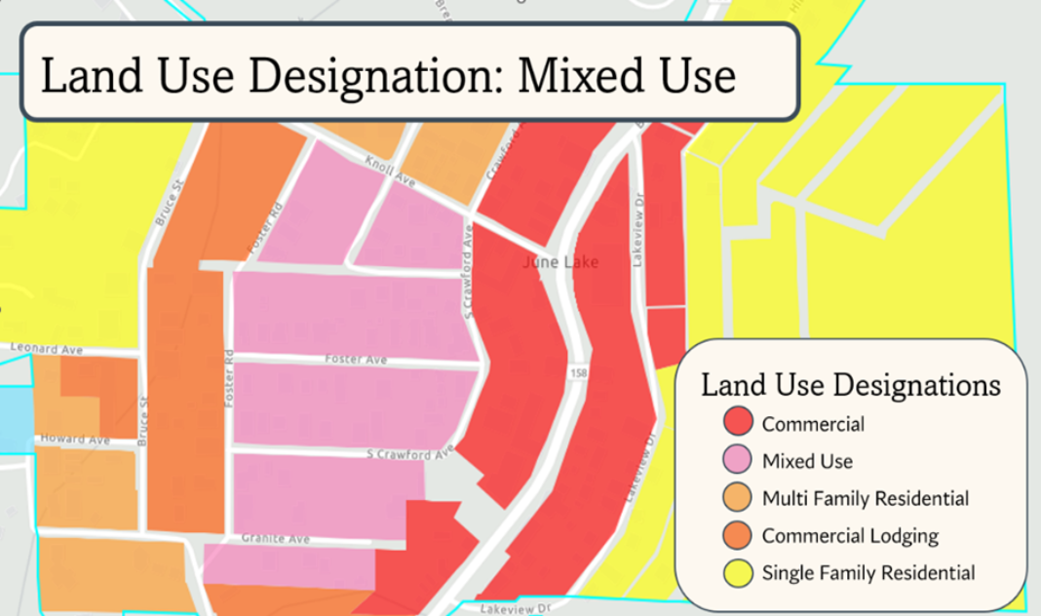

Slide 13
General Plan Consistency – Countywide Land Use Policies
Countywide Land Use Policies
Goal 1. Maintain and enhance the environmental and economic integrity of Mono County while providing for the land use needs of residents and visitors.
Objective 1.C. Provide a balanced and functional mix of land uses.
Objective 1.D. Provide for the housing needs of all resident income groups, and of part-time residents and visitors.
Notes:
Countywide land use policies in the General Plan’s Land Use Element emphasize the importance of finding a balance between the competing interests of residents and visitors. Policies addressing short-term rentals focus on limiting short-term rentals in residential land use designations; however, the subject parcel is designated mixed use and located within June Lake’s Central Business District.

Slide 14
General Plan Consistency – June Lake Area Plan Policies in Favor of Project
Objective 20.B. Diversify and stabilize the local economy by attracting and retaining tourist- and community-oriented businesses, particularly those that provide new jobs for local residents.
Objective 20.D. Increase visitation to June Lake.
Objective 13.I. Maintain the June Lake Village as the Loop's commercial core by providing a wide range of commercial and residential uses in a pedestrian-oriented atmosphere.
Notes:
The policies contained in the June Lake Area Plan acknowledge the complexity of transient and short-term rental permits in a community with limited housing and a strong reliance on tourism. Some policies favor transient rentals, some policies discourage them (especially in areas designated for residential use), but most favor case-by-case analysis.

Slide 15
General Plan Consistency – June Lake Area Plan Policies Which Discourage the Project
Goal 14. Provide residents and visitors with quality housing, a wide array of housing alternatives designed to promote unique experiences, and year-round housing stock; and promote adequate affordable housing.

Slide 16
General Plan Consistency – June Lake Area Plan Policies Which Favor Case-by-Case Analysis
Objective 13.M. To balance the character of single-family residential neighborhoods and the tourist economy, utilize a mix of best practices, creative solutions, and regulatory mechanisms, as guided by public input and engagement, to address the complexity of short-term rentals.
Objective 13.B. Promote well-planned and functional community development that retains June Lake’s mountain-community character and tourist-oriented economy.
Objective 13.H. Balance the development of recreational facilities with the adequate provision of public amenities, employee and visitor housing, infrastructure, and circulation facilities.

Slide 17
General Plan Consistency
Subject property is not presently in compliance with Dark Sky requirements
Subject property is not presently compliant with parking standards, but will be compliant once spaces are striped
Subject parcel not compliant with lot coverage standards (60%)
Subject property is compliant with all other Land Use Element standards, including setbacks, snow storage, etc.
Notes:
-Lot coverage is the only issue noted here which cannot be corrected via Conditions of Approval. Present lot coverage is 71%, compared to the max of 60% in the MU designation

Slide 18
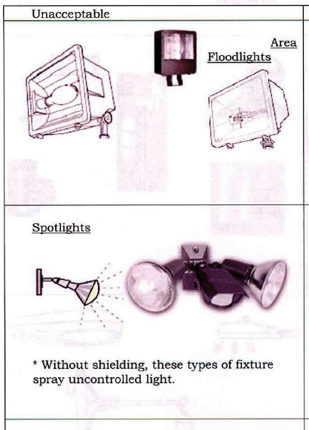
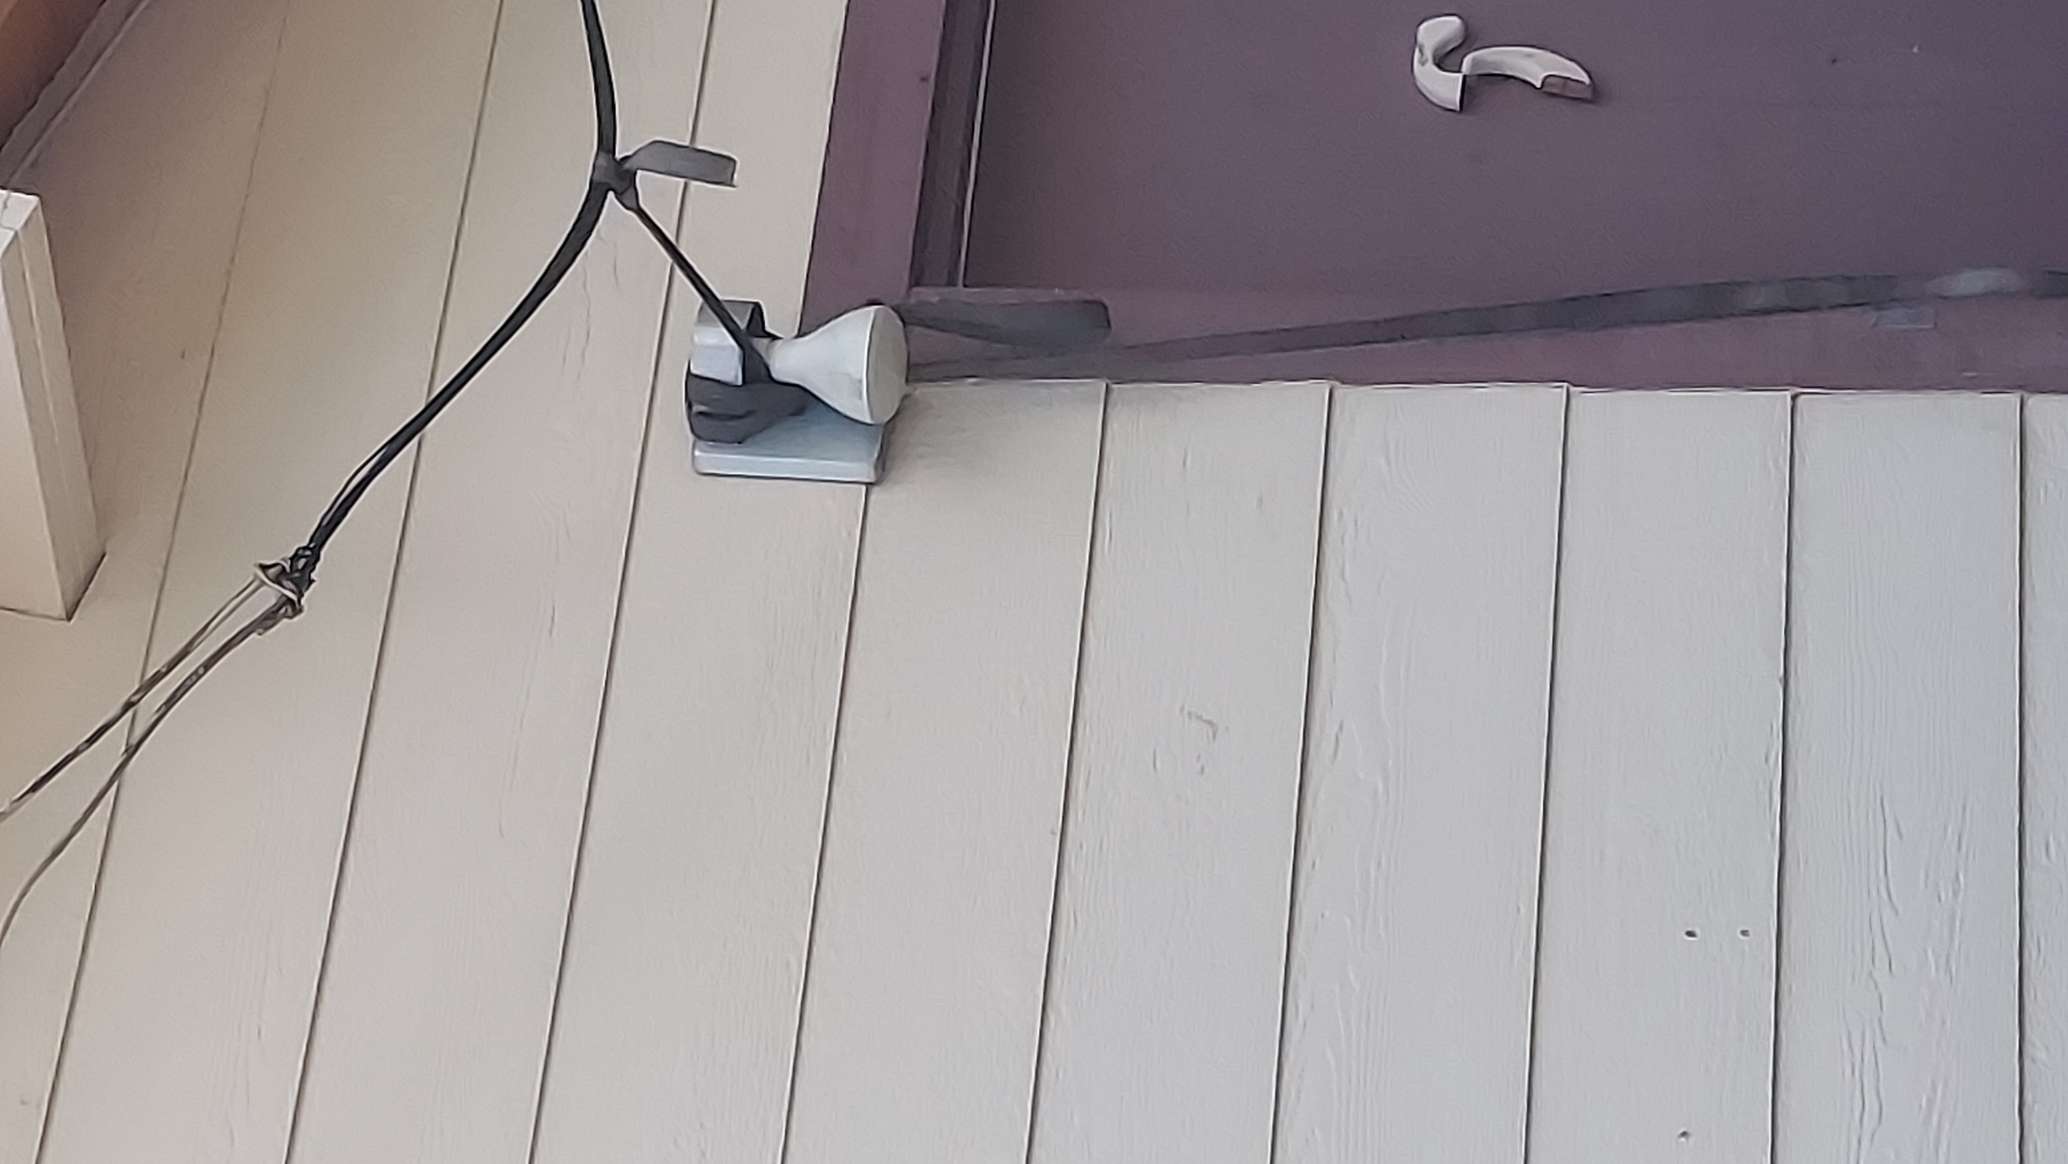
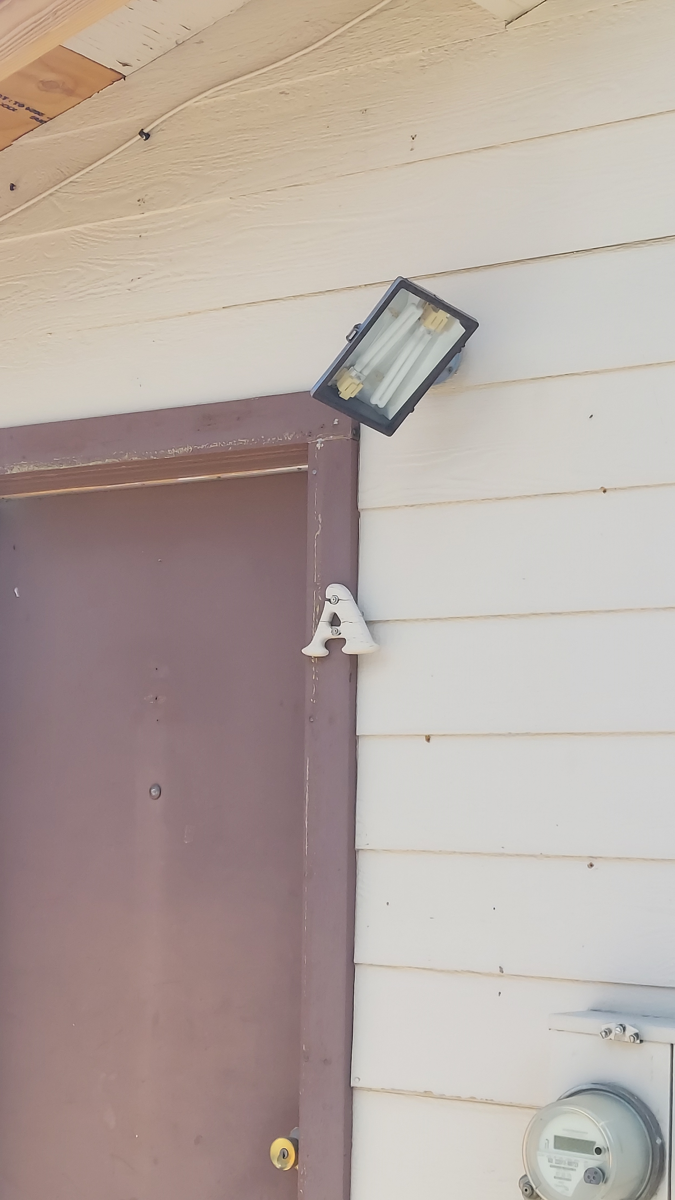
Dark Sky Compliance
Notes:
C of A added to require compliance with Dark Sky provisions prior to issuance of VHR permit.

Slide 19
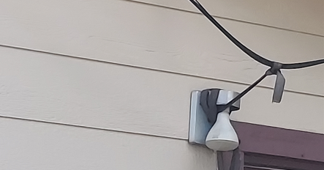
Notes:
Noticed this when taking dark sky photos. The power line appears to hang low and has been tied back to a light fixture to get it out of the way. Mono County Building Official has confirmed the line is too low to meet current Building Code standards. To resolve the issue, a condition of approval has been added to require compliance with the California Building Code prior to issuance of a VHR permit.

Slide 20
General Plan Consistency - Parking
Requirements
10 parking spaces
  4 for transient rentals
  4 for long-term tenants
  2 for guests of long-term tenants
Parking space dimensions of 10’ x 20’
All spaces must be paved and striped

Slide 21

Notes:
This is an image of what presently exists at the project site. The parking area is paved, but not striped, and measures 100’ in width by 28’ in depth.

Slide 22
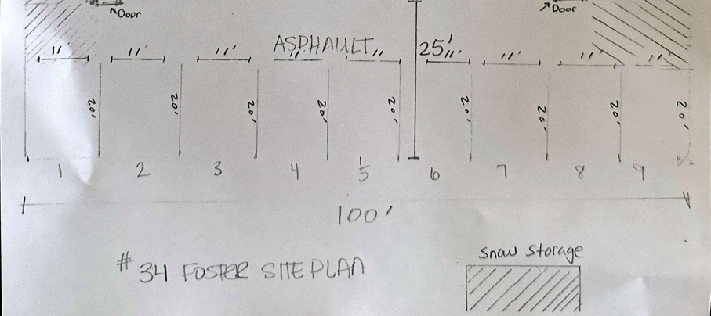
Notes:
The site plan provided by the applicant shows 11, 9x20 spaces, which does not meet parking stall size requirements. However, the parking area is 100’ x 28’, meaning there is sufficient space for ten, 10x20 spaces. Striping must also be added to the parking lot to meet parking requirements.

Slide 23
General Plan Consistency - Parking
Conditions of Approval to Ensure Compliance with Mono County Parking Standards:
#4 – Minimum of 10 parking spaces, delineated with striping in accordance with Figure 06.010 of the MCGP LUE (which shows minimum space dimensions of 10’ x 20’)
#5 – Two spaces designated for each transient rental unit with signage identifying the spaces
#6 – Maximum of two vehicles per transient rental unit, or four vehicles in total, allowed to park at the project site
#7 – No off-site or street parking
Notes:
In other words, the parcel can meet all parking requirements with the available space and conditions of approval have been added to ensure all requirements are met.
All of this is required prior to issuance of a VHR permit

Slide 24
General Plan Consistency - Setbacks
In the 2022 hearing, rear setbacks and a shed within the side setbacks were issues
As of June 2025, it appears the setback issues have been cleared up
  Shed within side setback has been removed
  Fence has been installed along rear property line
  CDD staff ran into neighbors and confirmed there are no longer concerns regarding rear property line.
Subject parcel meets rear setback requirements with six inches to spare
All other setback requirements are also met.
Notes:
All of this is required prior to issuance of a VHR permit

Slide 25
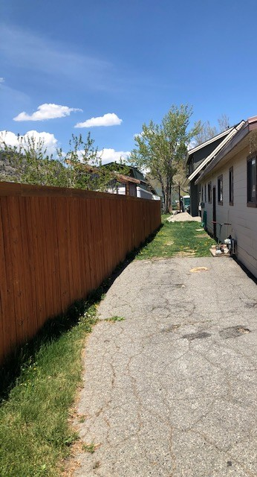
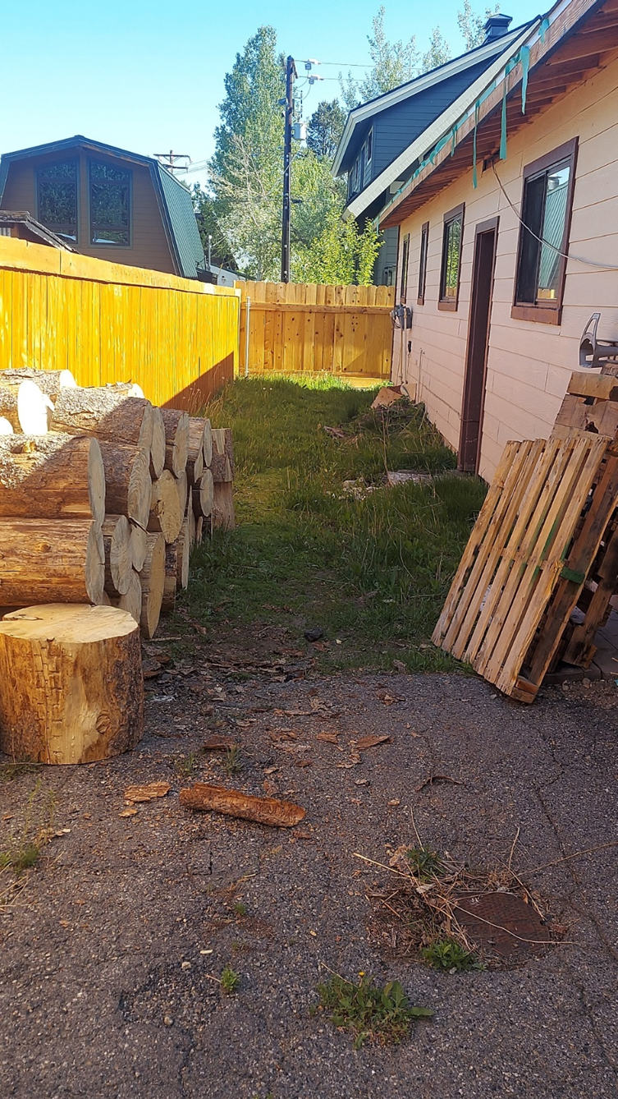
General Plan Consistency – Setbacks (rear property line)
2022
2025
Notes:
All of this is required prior to issuance of a VHR permit

Slide 26
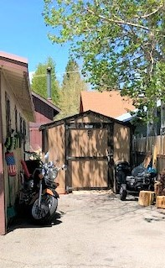
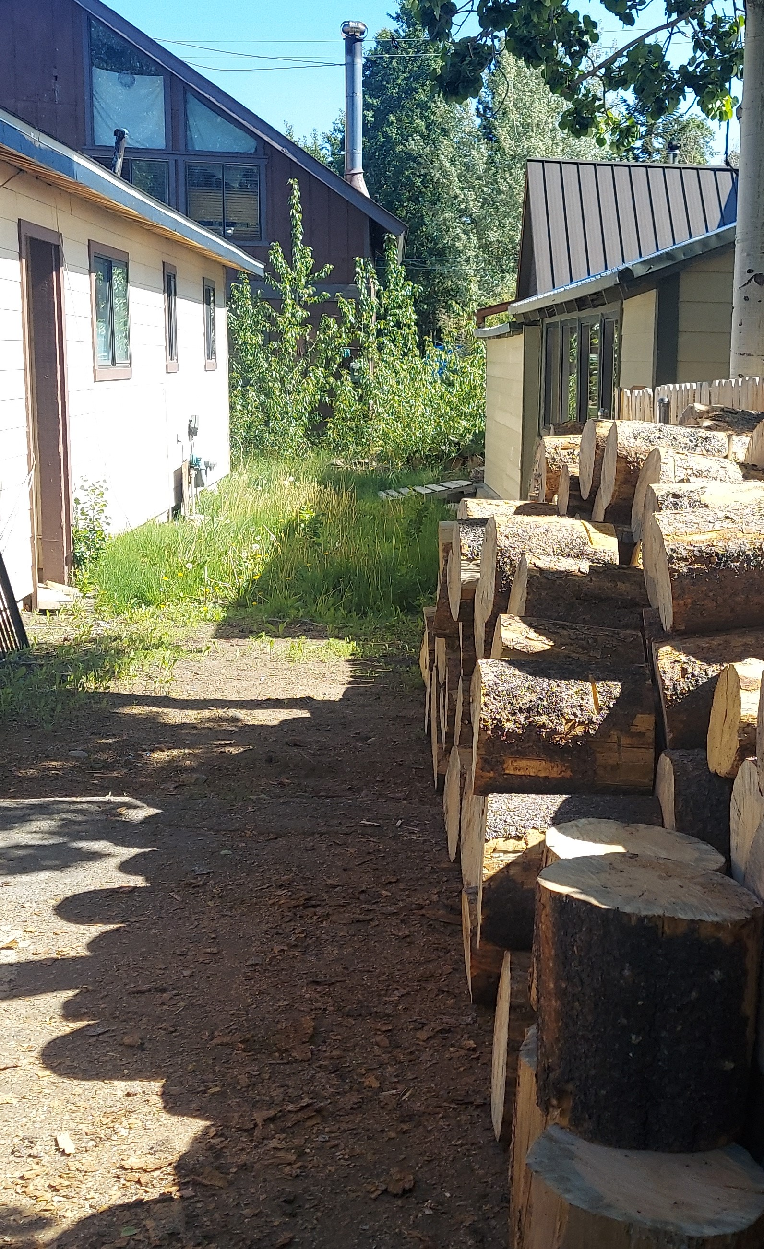
2022
2025
General Plan Consistency – Setbacks (shed)
Notes:
All of this is required prior to issuance of a VHR permit

Slide 27
General Plan Consistency – Snow Storage
In the 2022 hearing, insufficient snow storage area was an issue
As of June 2025, it appears the snow storage area issue has been cleared up with removal of the shed that was present in 2022
Subject parcel meets snow storage requirements with 40 square feet to spare
  65% of the area from which snow will be removed is required for snow storage
    Cumulative area requiring snow removal is 3,438 sf
    Snow storage area is required to be at least 2,228 sf
    Subject parcel has 2,268 sf of snow storage area
Certain snow storage areas are currently being used to store other things, such as firewood
  Condition of Approval added to require snow storage areas be cleared prior to issuance of VHR permit
Notes:
All of this is required prior to issuance of a VHR permit

Slide 28
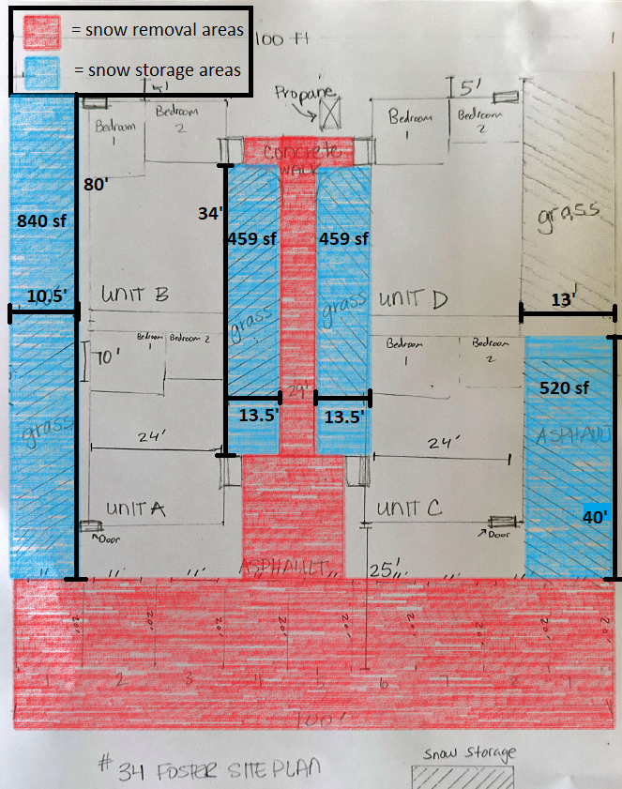
General Plan Consistency – Snow Storage

Slide 29
Recent Decisions on Transient Rental Applications
UP 22-004 (Valletta) – Denied by PC (6/22); decision affirmed by BoS in Appeal 22-01 (8/22)
UP 24-004 (Morgan) – Approved by PC (8/24)
UP 24-009 (Poe) – Denied by PC (2/25); decision affirmed by BoS in Appeal 24-02 (2/25); lawsuit filed
UP 25-002 (Monteverde) – Denied by PC (2/25); decision tentatively overturned by BoS in Appeal 25-01 (6/25)

Slide 30
Public Comments Received
NONE

Slide 31
Use Permit Finding #1
All applicable provisions of the Mono County General Plan are complied with, and the site of the proposed use is adequate in size and shape to accommodate the use and to accommodate all yards, walls and fences, parking, loading, landscaping and other required features because:
The property fails to meet all General Plan Land Use Element policies, including the following:
  Lot coverage
  Dark Sky (to be brought into compliance prior to issuance of a Vacation Home Rental Permit)
This finding cannot be made.
OR

Slide 32
Alternative Use Permit Finding #1
All applicable provisions of the Mono County General Plan are complied with, and the site of the proposed use is adequate in size and shape to accommodate the use and to accommodate all yards, walls and fences, parking, loading, landscaping and other required features because:
Transient rentals are permitted in Mixed Use land use designations, subject to use permit
The property has adequate space for parking
The property will meet all General Plan Land Use Element policies with the Conditions of Approval, except for lot coverage
This finding can be made.

Slide 33
Use Permit Finding #2
The site for the proposed use related to streets and highways is adequate in width and type to carry the quantity and kind of traffic generated by the proposed use because:
The project site is in a mixed use district and located within June Lake’s Central Business District
The property is accessed from Foster Avenue, which is a county road that is plowed in the winter
Traffic is not expected to significantly increase if two of four units are utilized as transient rentals rather than as primary residences
All parking must occur on site
Parking area meets Ch 22 Fire Safe Standards
This finding can be made.

Slide 34
Use Permit Finding #3
The proposed use will not be detrimental to the public welfare or injurious to property or improvements in the area on which the property is located because:
Approval would convert two historically long-term rentals into visitor accommodations. Due to the lack of housing availability for local residents and employees, the use of residential housing stock for transient rental is detrimental to the public welfare.
The size of the units is appropriate for workforce rentals or starter homes and until housing availability increases, allowing the rental of residential property to visitors rather than use as a traditional residence by the owner or rental to persons in need of housing to live in the area is detrimental to the public welfare.
Visitor accommodations should be provided intentionally through facilities built for that purpose, such as hotels and motels.
This finding cannot be made.
OR

Slide 35
Alternative Use Permit Finding #3
This finding can be made.
The proposed use is not expected to cause significant environmental impacts.
The property is designated for mixed use, and the proposed use is consistent with its designation.
The applicant shall comply with requirements established in MCGP LUE Chapter 26, Transient Rental Standards & Enforcement in Nonresidential and MFR-H Land Use Designations and TRODs. The standards and requirements minimize fire hazards, noise, traffic, parking conflicts, and disturbance to the peace and quiet.

Slide 36
Use Permit Finding #4
The proposed use is consistent with the map and text of the Mono County General Plan because:
The project is inconsistent with June Lake Issues/Opportunities/Constraints.
  The majority of the June Lake Loop's rental and affordable units exists in the Village.
  The relatively small resident population, an estimated 630 persons (2010 Census), does not constitute a viable economic foundation. Studies have indicated that a population of 1,500 to 2,000 persons is needed to create a self-supporting consumer economy. Presently, most residents conduct their shopping in Mammoth Lakes or, when major purchases are involved, in Bishop or Reno.
  Housing or lodging facilities are oriented primarily to second-home owners and tourists, not to local housing needs.
Allowing two units to be converted into transient rentals will remove units from the long-term rental market available to the local workforce.
This finding cannot be made.

Slide 37
Alternative Use Permit Finding #4
The proposed use is consistent with the map and text of the Mono County General Plan because:
The MU land use designation provides for transient rentals, subject to Use Permit.
The project is located within the June Lake commercial core. June Lake Area Plan policies encourage a diverse set of commercial uses, including lodging, with pedestrian access to the commercial core.
This finding can be made.

Slide 38
Conditions of Approval
Prior to conducting business, the property owner(s) shall receive a Vacation Home Rental permit and comply with Mono County General Plan Chapter 26 “Transient Rental Standards & Enforcement in Nonresidential and MFR-H Land Use Designations and TRODS,” a Mono County Transient Occupancy Tax Certificate, and a Mono County business license. Payment of any applicable Housing Mitigation Ordinance fees is also required prior to conducting any transient rental business at the project site.Future development shall meet requirements of Mono County including, but not limited to, the General Plan, Mono County Code, and project conditions.
Transient rental is limited to two units only. The applicant shall identify the units on the Vacation Home Rental permit applications. Occupancy shall not exceed six renters per rental unit.
Two units are required to be rented on a long-term basis. Any reporting and accountability required by Mono County to demonstrate renting in good faith must be complied with by the applicant.

Slide 39
Conditions of Approval
A minimum of ten parking spaces, which shall be delineated with striping in accordance with the approved parking layouts shown in figure 06.010 of the MCGP LUE, are required.
Two parking spaces per unit shall be designated for transient rental use with signage identifying the spaces. Transient renters may not parkin in any other locations.
A maximum of two vehicles per unit, or four vehicles total, are allowed to park on the property for transient rental. At no time shall the number of vehicles present exceed the two parking spaces per unit designated for transient rental guests.
Vehicle parking shall occur only on the property. Off-site and on-street parking are prohibited. Vehicle(s) shall not obstruct the flow of traffic on Foster Avenue.
All transient rental customers must sleep within the dwelling; customers are prohibited from sleeping in an RV, travel-trailer, or similar mobile-living unit on the property or any neighboring property.

Slide 40
Conditions of Approval
A minimum of ten parking spaces, which shall be delineated with striping in accordance with the approved parking layouts shown in figure 06.010 of the MCGP LUE, are required.
Two parking spaces per unit shall be designated for transient rental use with signage identifying the spaces. Transient renters may not parkin in any other locations.
A maximum of two vehicles per unit, or four vehicles total, are allowed to park on the property for transient rental. At no time shall the number of vehicles present exceed the two parking spaces per unit designated for transient rental guests.
Vehicle parking shall occur only on the property. Off-site and on-street parking are prohibited. Vehicle(s) shall not obstruct the flow of traffic on Foster Avenue.
All transient rental customers must sleep within the dwelling; customers are prohibited from sleeping in an RV, travel-trailer, or similar mobile-living unit on the property or any neighboring property.

Slide 41
Conditions of Approval
All exterior lighting shall be shielded and directed downward to comply with Chapter 23, Dark Sky Regulations prior to issuance of a Vacation Home Rental permit.
A sufficient number of wildlife-resistant trash receptacles shall be available at the project site. Trash and other solid waste shall not be allowed to accumulate in or around the property and shall be removed promptly to a designated landfill, transfer station or other designated site. Property management shall be responsible for the cleanup if the tenants or transient rental guests do not properly dispose of trash in wildlife-resistant containers.
In order to qualify as a transient rental, the building cannot be substandard as defined by the California Health and Safety code.
The low-hanging power line in Figure 10 of this report must be brought into compliance with the California Building Code and pass an inspection performed by Mono County Building Division staff prior to issuance of a Vacation Home Rental permit.

Slide 42
Conditions of Approval
The project is required to comply with any requirements of the June Lake Fire Protection District.
Transient rental units shall meet the standards and requirements of Mono County General Plan Chapter 26.
The project shall comply with provisions of the Mono County General Plan including Chapter 26, Mono County Code, project description, and all conditions.
Future development shall meet all requirements of Mono County including, but not limited to, the General Plan, Mono County Code, and project conditions and site plan.
The project shall comply with applicable requirements by other Mono County departments and divisions including, but not limited to, Mono County Building Division, Public Works, and Environmental Health requirements, and any California state health orders.

Slide 43
Conditions of Approval
The project is required to comply with any requirements of the June Lake Fire Protection District.
Transient rental units shall meet the standards and requirements of Mono County General Plan Chapter 26.
The project shall comply with provisions of the Mono County General Plan including Chapter 26, Mono County Code, project description, and all conditions.
Future development shall meet all requirements of Mono County including, but not limited to, the General Plan, Mono County Code, and project conditions and site plan.
The project shall comply with applicable requirements by other Mono County departments and divisions including, but not limited to, Mono County Building Division, Public Works, and Environmental Health requirements, and any California state health orders.

Slide 44
Conditions of Approval
Appeal
Termination
Extensions
Revocation

Slide 45
Staff Recommendation
Hold the public hearing, receive public testimony, deliberate the project, and make any desired changes; and
Determine that the required use permit findings cannot be made and disapprove Use Permit 25-004 (Valletta). (Projects which a public agency rejects or disapproves are statutorily exempt under CEQA §15270.)
  OR

Slide 46
Alternative Staff Recommendation
Hold the public hearing, receive public testimony, deliberate the project, and make any desired changes;
Find the project qualifies as a Categorical Exemption under CEQA guidelines 15301 and instruct staff to file a Notice of Exemption; and
Make the required findings as contained in the project staff report and approve Use Permit 22-004 (Valletta) subject to Conditions of Approval.

Slide 47
Next Steps (if Use Permit is approved)
Vacation Home Rental Permit
  Dark Sky and parking standards compliance required
  Low-hanging power line must meet CA Building Code
  Payment of Housing Mitigation Ordinance fees ($4.76/sf)
Business License
Transient Occupancy Tax certificate
Notes:
All of this is ministerial. No additional discretionary permits are required.

Slide 48
Use Permit 25-004
Questions?

