Slide 1
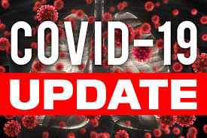



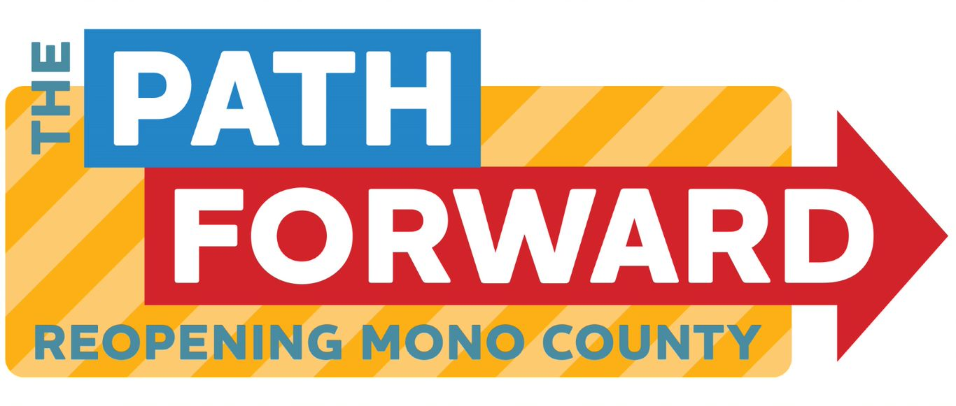
Board of supervisors meeting July 5, 2022

Slide 2
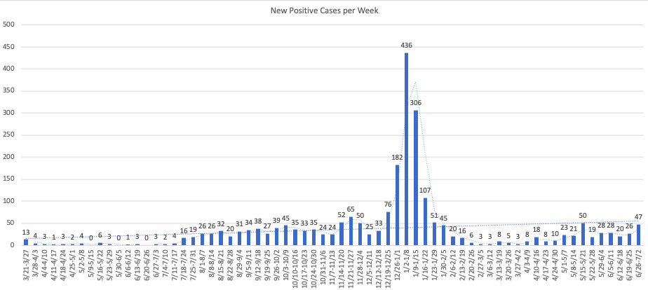
Mono county metrics Tested – 2,553 Negative – 2,347 pending - 125 Positive – 84 deaths - 1 positivity rate – 3.29%
Total positive cases (PCR Conf): 3081 Positivity rate: 9.5%/ Case Rate/100,000: 48.1

Slide 3
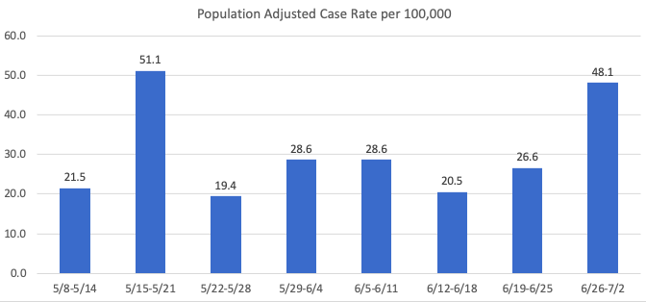
Recent mETrics

Slide 4
Number of POSITIVE cases by week for the past month
6/5 -6/11: 28
6/12 - 6/18: 20
6/19 - 6/25: 26
6/26 - 7/2: 47

Slide 5
Hospital Status
No current COVID-19 related hospitalizations
3 recent brief hospitalizations in Mono County
2 of the 3 were visitors
Status = Green

Slide 6
Omicron Variants of concern
BA.4 and BA.5 are now the dominant strains accounting for over 50% of cases
BA.5 may have a growth advantage over BA.4

