Slide 1
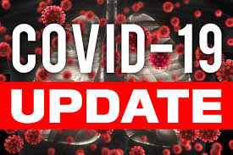




Board of supervisors meeting June 21, 2022

Slide 2
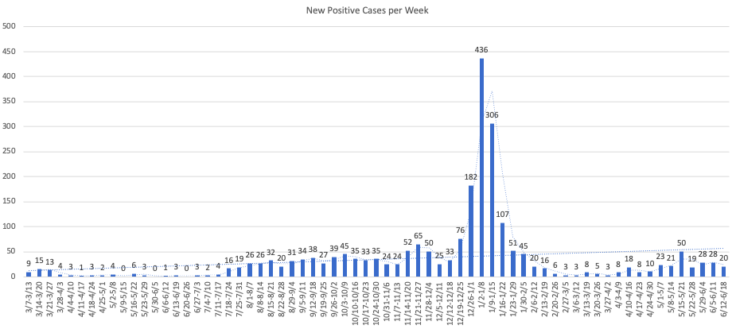
Mono county metrics Tested – 2,553 Negative – 2,347 pending - 125 Positive – 84 deaths - 1 positivity rate – 3.29%
Total positive cases (PCR Conf): 3066 Positivity rate: 13.2%/ Case Rate/100,000: 20.5

Slide 3
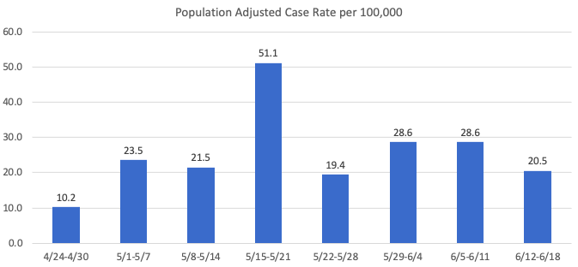
Recent mETrics

Slide 4
Covid related Mono County Death
A Mono County resident recently passed away with COVID-19 being a contributing factor.

Slide 5
Number of POSITIVE cases by week for the past month
5/22 -5/28: 19
5/29 -6/4: 28
6/5 -6/11: 28
6/12 -6/18: 20

Slide 6
Hospital Status
one current COVID-19 related hospitalizations
Status = Green

Slide 7
Vaccines approved for children aged six months to five years
June 21, 2022 – On June 19, 2022, the California Department of Public Health (CDPH) announced supporting the Western States Scientific Safety Review Workgroup, the American Academy of Pediatrics, the U.S. Food and Drug Administration, and the Centers for Disease Control and Prevention (CDC) in recommending Emergency Use Authorization (EUA) of the Pfizer-BioNTech and Moderna COVID-19 (Coronavirus) vaccines for children as young as six months.
“COVID-19 has become one of the top five leading causes of death in children, and vaccines make these deaths preventable,” said Dr. Caryn Slack, MD, MPH, Mono County Health Officer. “We are pleased that COVID-19 protection is now available for the whole family.”
The EUA will add young children aged six months through four years old to those eligible to receive a Pfizer vaccine (three doses), and children and adolescents aged six months through 17 years old to get a Moderna vaccine (two doses).

