Slide 1
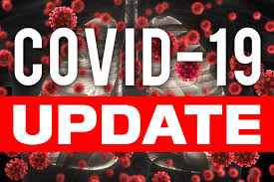




Board of supervisors meeting May 17, 2022

Slide 2
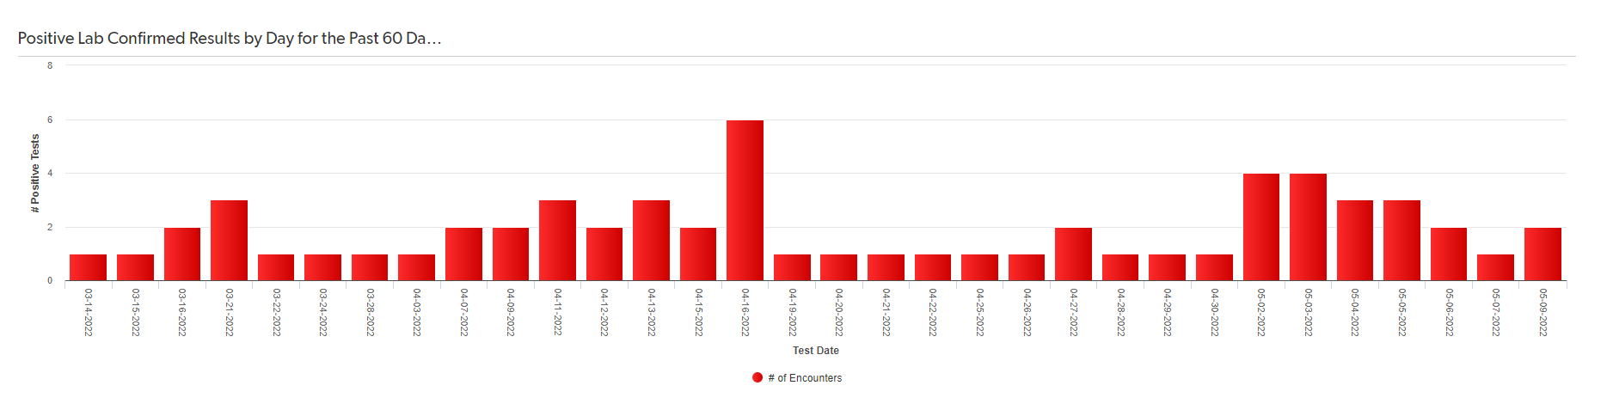
Mono county metrics Tested – 2,553 Negative – 2,347 pending - 125 Positive – 84 deaths - 1 positivity rate – 3.29%
Total positive cases (PCR Conf): 2997 Positivity rate: 8%/ Case Rate/100,000: 20.5

Slide 3
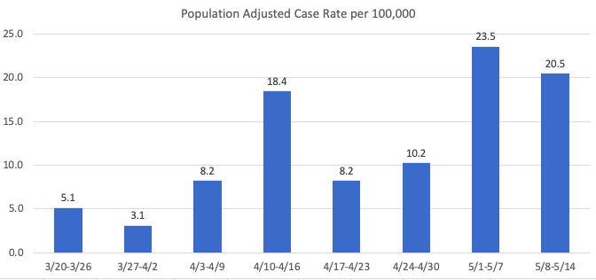
Recent mETrics

Slide 4
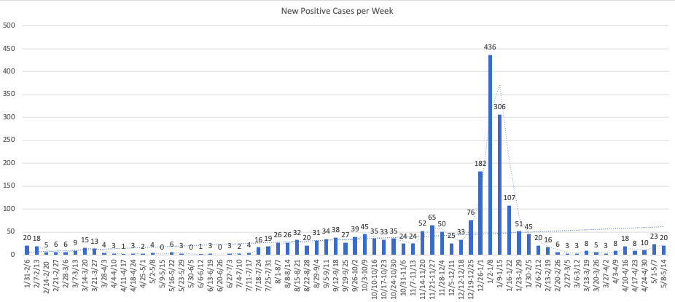

Slide 5
Number of POSITIVE cases by week for the past month
4/17 – 4/23: 8
4/24 -4/30: 10
5/1 -5/7: 23
5/8 -5/14: 20

Slide 6
Hospital Status
No current COVID-19 related hospitalizations
Status = Green

Slide 7
Major Milestone
1,000,000 + U.S. COVID-19 related deaths
1/330
675,000 Spanish Flu related deaths
620,000 Civil War deaths
405,399 World War II deaths
117,000 World War I deaths
47,434 Vietnam War deaths
12,000 – 52,000 annual Flu deaths

Slide 8
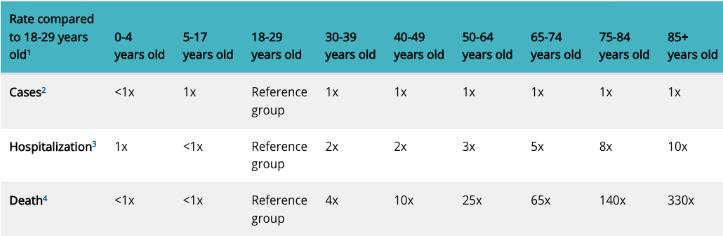
Risk for COVID-19 Infection, Hospitalization, and Death By Age Group
Source: https://www.cdc.gov/coronavirus/2019-ncov/covid-data/investigations-discovery/hospitalization-death-by-age.html

Slide 9
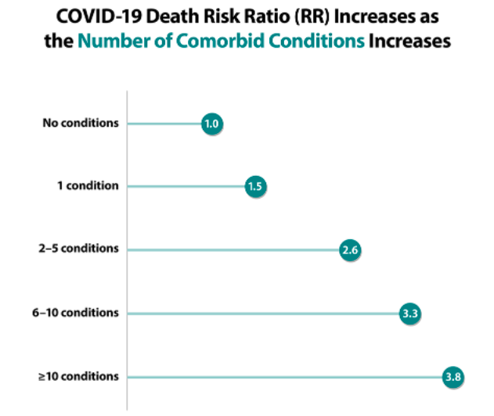
COVID-19 death risk ratio & comorbid conditions
Source: https://www.cdc.gov/coronavirus/2019-ncov/hcp/clinical-care/underlyingconditions.html

Slide 10
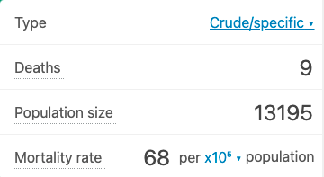
Mono county covid mortality rate
(per 100,000)
Mortality rate for influenza in CA (2019) was 12.5.
Source: https://www.cdc.gov/nchs/pressroom/sosmap/flu_pneumonia_mortality/flu_pneumonia.htm

