Slide 1
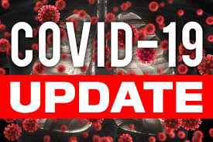



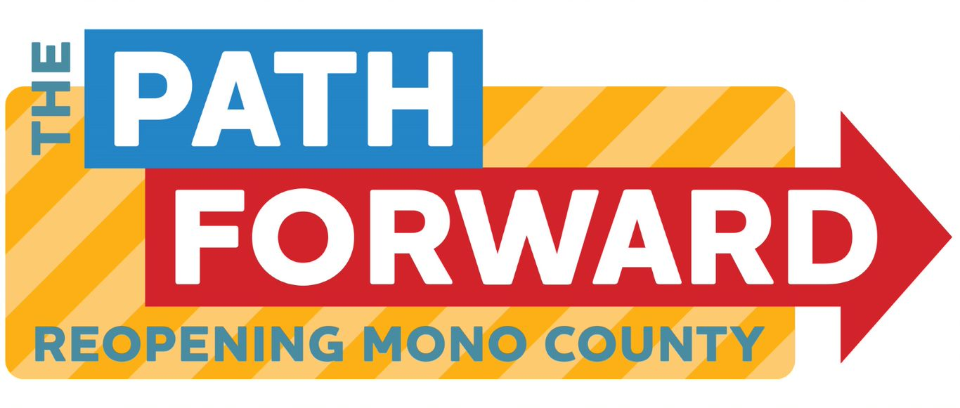
Board of supervisors meeting May 10, 2022

Slide 2
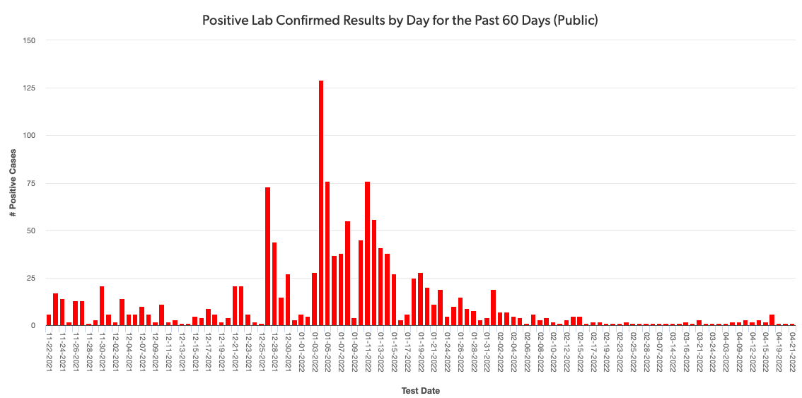
Mono county metrics Tested – 2,553 Negative – 2,347 pending - 125 Positive – 84 deaths - 1 positivity rate – 3.29%
Total positive cases (PCR Conf): 2997 Positivity rate: 4.7%/ Case Rate/100,000: 23.5

Slide 3
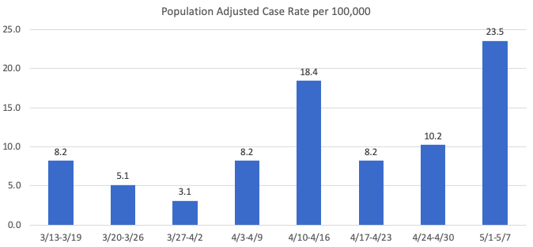
Recent mETrics

Slide 4
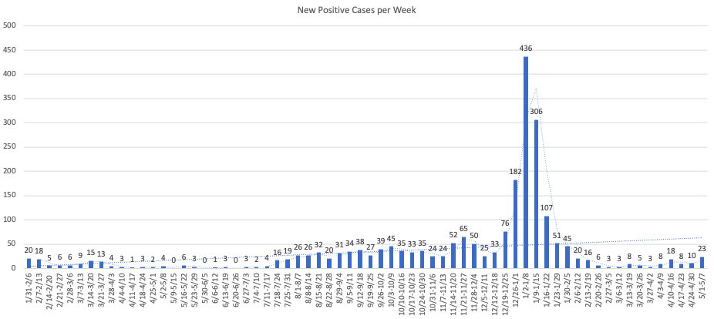

Slide 5
Number of POSITIVE cases by week for the past month
4/10 – 4/16: 18
4/17 – 4/23: 8
4/24 -4/30: 10
5/1 -5/7: 23

Slide 6
Hospital Status
No current COVID-19 related hospitalizations
Status = Green

