Slide 1





Board of supervisors meeting May 03, 2022

Slide 2
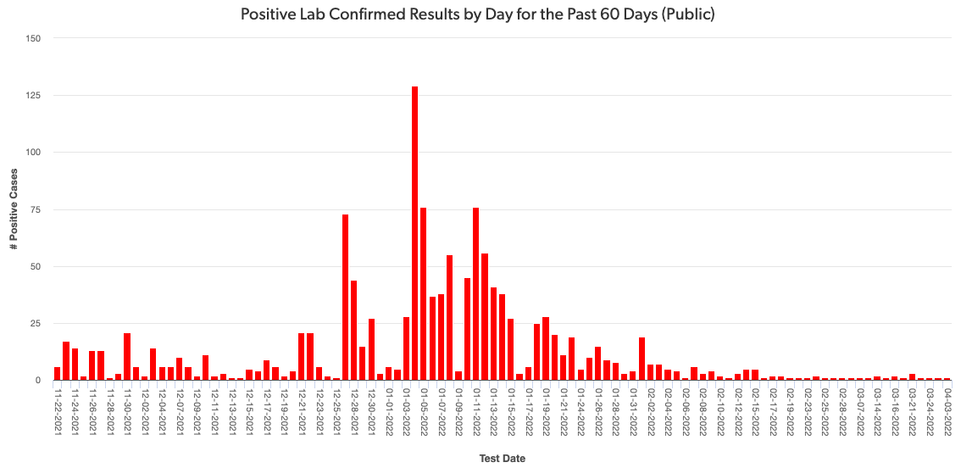
Mono county metrics Tested – 2,553 Negative – 2,347 pending - 125 Positive – 84 deaths - 1 positivity rate – 3.29%
Total positive cases (PCR Conf): 2989 Positivity rate: 9.2%/ Case Rate/100,000: 12.3

Slide 3
Recent mETrics

Slide 5
Number of POSITIVE cases by week for the past month
4/3 – 4/9: 8
4/10 – 4/16: 18
4/17 – 4/23: 12
4/24 -4/30: 12

Slide 6
Hospital Status
No current COVID-19 related hospitalizations
Status = Green

Slide 7
Covid-19 Variants of interest
BA.2.12.1: The BA.2.12.1 is spreading rapidly and overtaking the BA.2 Omicron subvariant.
Little is known about the new subvariant; however, it appears to be highly transmissible, much like its ancestors.
BA 4 and 5: Two new Omicron variants sweeping South Africa—likely able to evade vaccines and natural immunity from previous infections.
Have been identified in the U.S.

Slide 8
Hepatitis and youth cases
As of April 21st, at least 169 cases of acute hepatitis of unknown origin have been reported from 11 countries in the WHO European Region and one country in the WHO Region of the Americas.
Cases have been reported in the United Kingdom of Great Britain and Northern Ireland (the United Kingdom) (114), Spain (13), Israel (12), the United States of America (9), Denmark (6), Ireland (<5), The Netherlands (4), Italy (4), Norway (2), France (2), Romania (1), and Belgium (1).

Slide 9
Hepatitis and youth cases
Adenovirus has been detected in at least 74 cases, and of the number of cases with information on molecular testing, 18 have been identified as F type 41.
SARS-CoV-2 was identified in 20 cases of those that were tested.
Furthermore, 19 were detected with a SARS-CoV-2 and adenovirus co-infection.

Slide 10
Avian Flu H5N1
A person has tested positive for avian influenza A(H5) virus (H5 bird flu) in the U.S., as confirmed by the Centers for Disease Control and Prevention (CDC) and reported by the Colorado Department of Public Health and Environment on April 28, 2022.
This case occurred in a person who had direct exposure to poultry and who was involved in the culling (depopulating) of poultry with presumptive H5N1 bird flu.

