Slide 1
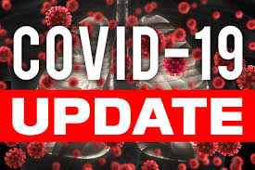



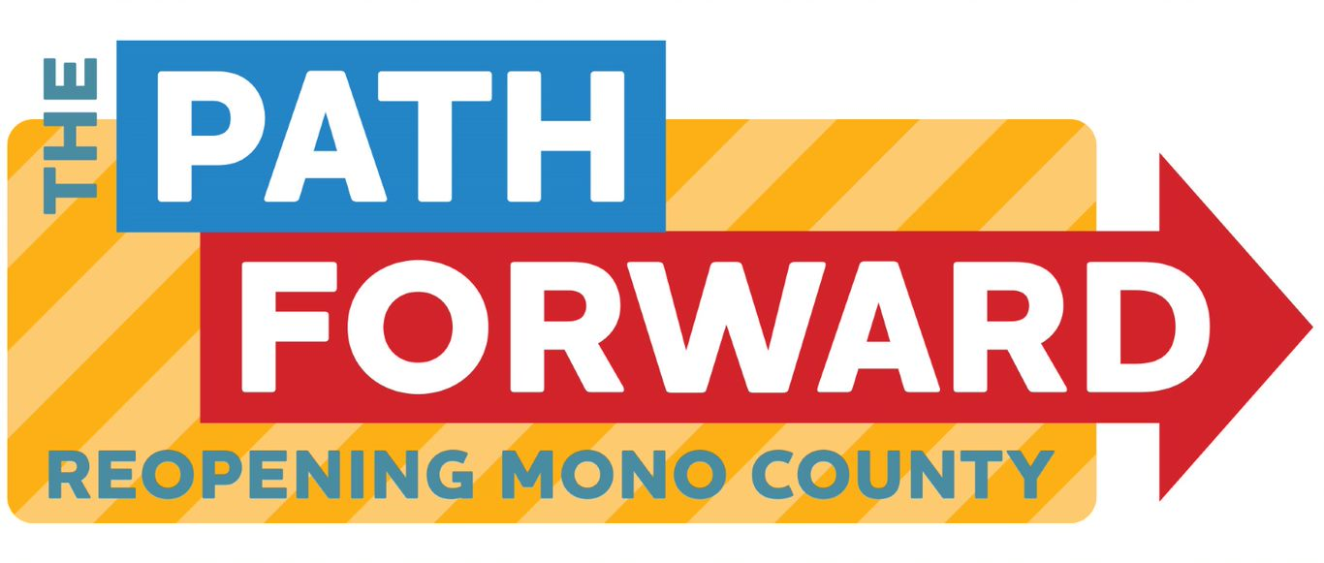
Board of supervisors meeting april 19, 2022

Slide 2
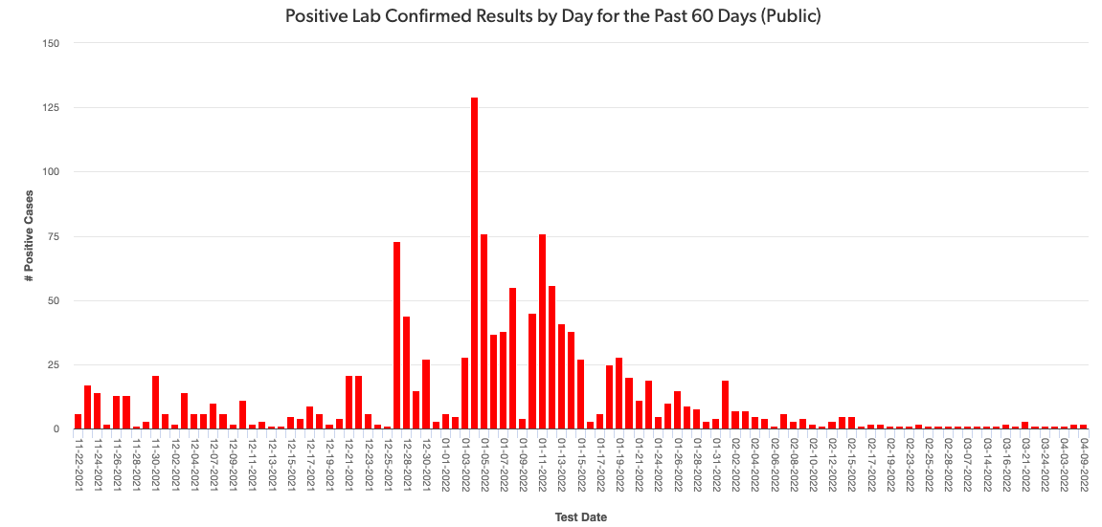
Mono county metrics Tested – 2,553 Negative – 2,347 pending - 125 Positive – 84 deaths - 1 positivity rate – 3.29%
Total positive cases (PCR Conf): 2983 Positivity rate: 0.9%/ Case Rate/100,000: 18.4

Slide 3
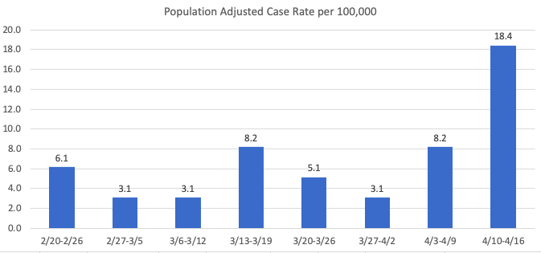
Recent mETrics

Slide 4
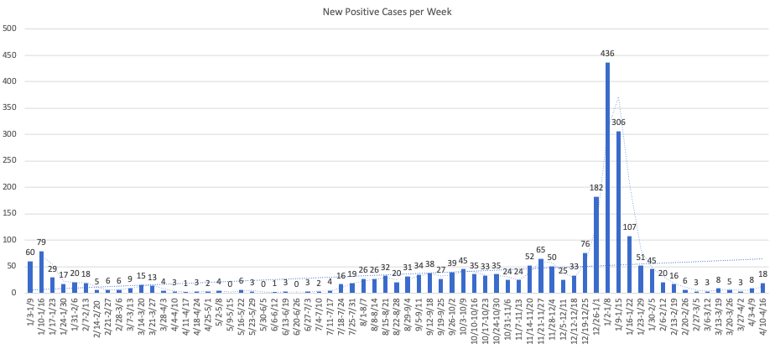

Slide 5
Number of POSITIVE cases by week for the past month
3/20 – 3/26: 5
3/27 – 4/2: 3
4/3 – 4/9: 8
4/10 – 4/16: 18

Slide 6
Hospital Status
No current COVID-19 related hospitalizations
Status = Green

Slide 7
BA.2 and other Variants
90%+ of all California cases are BA.2
Other variants being monitored
XE
BA.2.12.1

Slide 8
Planes and public transportation
A federal Judge overturned the masking mandate for planes and all forms of public transportation
Masks are currently not required for transit
Unclear if the Biden administration will challenge the ruling

